Slide 1
ServletConfig Interface:-
During initialization of Servlets, web container creates one ServletConfig for each Servlet. ServletConfig can be used to get servlet information from web.xml file.
We can pass any information of servlet in our web.xml file and can use this information in servlet using ServletConfig.
Creating object of ServletConfig -
We can get a reference (object) to ServletConfig by using getServletConfig() method. As we know our servlets already inherit getServletConfig(), So we can directly use it to get a reference to ServletConfig as follows -
ServletConfig sc = getServletConfig();

Slide 2
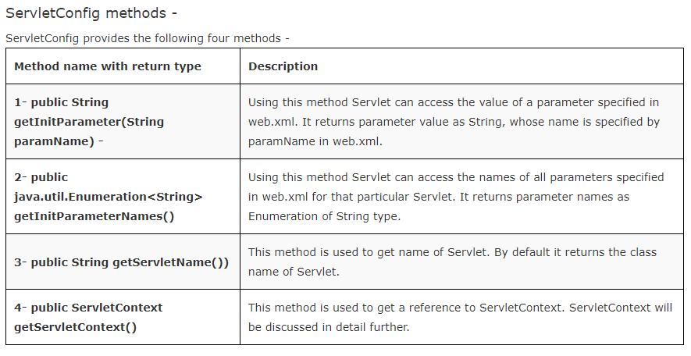

Slide 3
Example -
This example will show you how to use ServletConfig to get all the information specified by you in web.xml for any particular Servlet.
1- index.html or index.jsp This will be your default page.
Add the following code to it -
<html>
<head>
<title>TODO supply a title</title>
<meta charset="UTF-8">
<meta name="viewport" content="width=device-width, initial-scale=1.0">
</head>
<body>
<h1>ServletConfig Demo</h1>
<a href="FirstServ">Get Information of First Servlet</a>
<br>
<a href="SecondServ">Get Information of Second Servlet</a>
</body>
</html>

Slide 4
2- Create a package named servs and within servs create two servlets named FirstServ and SecondServ.
Add the following code in servlets -
FirstServ Servlet -
package servs;
import java.io.*;
import javax.servlet.*;
import javax.servlet.http.*;
public class FirstServ extends HttpServlet {
public void doGet(HttpServletRequest request, HttpServletResponse response)
throws ServletException, IOException {
try
{
PrintWriter out = response.getWriter();
out.println("<!DOCTYPE html>");
out.println("<html>");
out.println("<head>");
out.println("<title>Servlet FirstServ</title>");

Slide 5
out.println("</head>");
out.println("<body>");
ServletConfig sc = getServletConfig();
String name = sc.getInitParameter("UserName");
String email = sc.getInitParameter("Email");
out.println("User Name is - "+name+"<br>");
out.println("Email id is - "+email+"<br>");
java.util.Enumeration<String> paramNames = sc.getInitParameterNames();
out.println("Parameter Names are - "+"<br>");
while(paramNames.hasMoreElements())
{
out.println(paramNames.nextElement());
}
String servlet_name = sc.getServletName();

Slide 6
out.println("<br>");
out.println("Servlet Name is - "+servlet_name);
out.println("</body>");
out.println("</html>");
}
catch(Exception ex)
{
System.out.println(ex);
}
}
}

Slide 7
SecondServ Servlet -
package servs;
import java.io.*;
import javax.servlet.*;
import javax.servlet.http.*;
public class SecondServ extends HttpServlet {
public void doGet(HttpServletRequest request, HttpServletResponse response)
throws ServletException, IOException {
try
{
PrintWriter out = response.getWriter();
out.println("<!DOCTYPE html>");
out.println("<html>");
out.println("<head>");
out.println("<title>Servlet SecondServ</title>");
out.println("</head>");
out.println("<body>");
ServletConfig sc = getServletConfig();

Slide 8
String name = sc.getInitParameter("UserName");
String email = sc.getInitParameter("Email");
out.println("User Name is "+name+"<br>");
out.println("Email id is "+email+"<br>");
java.util.Enumeration<String> paramNames = sc.getInitParameterNames();
out.println("Parameter Names are - "+"<br>");
while(paramNames.hasMoreElements())
{
out.println(paramNames.nextElement());
}
String servlet_name = sc.getServletName();
out.println("Servlet Name is "+servlet_name+"<br>");
out.println("</body>");
out.println("</html>");

Slide 9
}
catch(Exception ex)
{
System.out.println(ex);
}
}
}
3- web.xml (Deployment Descriptor) - Add the following code to web.xml file -
<?xml version="1.0" encoding="UTF-8"?>
<web-app>
<servlet>
<servlet-name>FirstServ</servlet-name>
<servlet-class>servs.FirstServ</servlet-class>
<init-param>
<param-name>UserName</param-name>
<param-value>Tom</param-value>
</init-param>
<init-param>
<param-name>Email</param-name>

Slide 10
<param-value>Tom@gettechnotes.com</param-value>
</init-param>
</servlet>
<servlet-mapping>
<servlet-name>FirstServ</servlet-name>
<url-pattern>/FirstServ</url-pattern>
</servlet-mapping>
<servlet>
<servlet-name>SecondServ</servlet-name>
<servlet-class>servs.SecondServ</servlet-class>
<init-param>
<param-name>UserName</param-name>
<param-value>Jerry</param-value>
</init-param>
<init-param>
<param-name>Email</param-name>
<param-value>Jerry@gettechnotes.com</param-value>

Slide 11
</init-param>
</servlet>
<servlet-mapping>
<servlet-name>SecondServ</servlet-name>
<url-pattern>/SecondServ</url-pattern>
</servlet-mapping>
</web-app>
Note - <init-param> shoud be within <servlet> tag.

Slide 12
javax.servlet.ServletContext Interface :-
ServletContext is used to share data between different parts (between different servlet's and jsp's)of our web application. In contrast with ServletConfig, one ServetContext is created for the complete web application that is shared by all the servlets and jsp in application.
ServletContext can also be used to get configuration information related to entire application from web.xml file.
ServletContext is created by container at the time of deployment of application and make it available for all the servlets and jsp available in web application.
Getting reference to ServletContext -
ServletContext is available within ServletConfig. We can create object of ServletContext by using ServletConfig, getServletContext() method as follows -
ServletConfig sc = getServletConfig();
ServletContext application = sc.getServletContext();
OR
ServletContext application = getServletConfig().getServletContext();

Slide 13
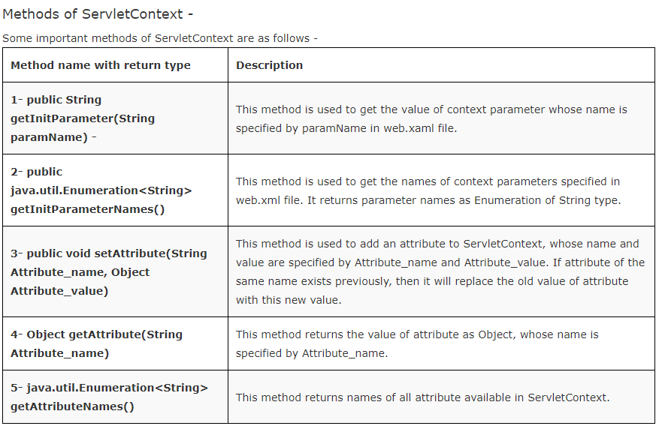

Slide 14
Example 1 -
This example will show you how to access configuration information related to entire application from web.xml using ServletContext.
1 - index.html or index.jsp - This will be your default page.
<!DOCTYPE html>
<html>
<head>
<title>ServletContext Demo</title>
<meta charset="UTF-8">
<meta name="viewport" content="width=device-width, initial-scale=1.0">
</head>
<body>
<h1>ServletContext Demo</h1>
<a href="FirstServ">Get ServletCotext info from First Servlet</a>
<br>
<a href="SecondServ">Get ServletCotext info from Second Servlet</a>
</body>
</html>

Slide 15
2- Create a package named servs and within servs create two servlets named FirstServ and SecondServ.
Add the following code in servlets -
FirstServ Servlet -
package servs;
import java.io.*;
import javax.servlet.*;
import javax.servlet.http.*;
public class FirstServ extends HttpServlet {
public void doGet(HttpServletRequest request, HttpServletResponse response)
throws ServletException, IOException {
response.setContentType("text/html;charset=UTF-8");
try
{
PrintWriter out = response.getWriter();

Slide 16
out.println("<h1>First Servlet</h1>");
ServletContext application = getServletConfig().getServletContext();
String nm = application.getInitParameter("Name");
String email = application.getInitParameter("Email");
out.println("Name is - "+ nm + "<br>");
out.println("Email is - "+ email + "<br>");
out.println("Parameters names are - ");
java.util.Enumeration<String> enu = application.getInitParameterNames();
while(enu.hasMoreElements())
{
out.println(enu.nextElement() + "<br>");
}
}
catch(Exception ex)
{
System.out.println(ex);
}
}
}

Slide 17
SecondServ Servlet -
package servs;
import java.io.*;
import javax.servlet.*;
import javax.servlet.http.*;
public class SecondServ extends HttpServlet {
public void doGet(HttpServletRequest request, HttpServletResponse response)
throws ServletException, IOException {
response.setContentType("text/html;charset=UTF-8");
try
{
PrintWriter out = response.getWriter();
out.println("<h1>Second Servlet</h1>");
ServletContext application = getServletConfig().getServletContext();
String nm = application.getInitParameter("Name");

Slide 18
String email = application.getInitParameter("Email");
out.println("Name is - "+ nm + "<br>");
out.println("Email is - "+ email + "<br>");
out.println("Parameter names are - ");
java.util.Enumeration<String> enu = application.getInitParameterNames();
while(enu.hasMoreElements())
{
out.println(enu.nextElement() + "<br>");
}
}
catch(Exception ex)
{
System.out.println(ex);
}
}
}

Slide 19
3- web.xml (Deployment Descriptor) - Add the following code to web.xml file -
<web-app>
<servlet>
<servlet-name>FirstServ</servlet-name>
<servlet-class>servs.FirstServ</servlet-class>
</servlet>
<servlet>
<servlet-name>SecondServ</servlet-name>
<servlet-class>servs.SecondServ</servlet-class>
</servlet>
<servlet-mapping>
<servlet-name>FirstServ</servlet-name>
<url-pattern>/FirstServ</url-pattern>
</servlet-mapping>
<servlet-mapping>
<servlet-name>SecondServ</servlet-name>
<url-pattern>/SecondServ</url-pattern>
</servlet-mapping>
<context-param>

Slide 20
<param-name>Name</param-name>
<param-value>Tom</param-value>
</context-param>
<context-param>
<param-name>Email</param-name>
<param-value>Tom@gettechnotes.com</param-value>
</context-param>
</web-app>
Note - <context-param> shoud be outside of all servlets and within <web-app> tag.

Slide 21
Example 2 -
This example will show you how to share data between different parts of application using setAttribute() and getAttribute() methods of ServletContext.
index.html or index.jsp - This will be your default page.
<!DOCTYPE html>
<html>
<head>
<title>ServletContextDemo_2</title>
</head>
<body>
<form method="post" action="FirstServ">
<table border="1px">
<tr>
<td>Name - </td>
<td><input type="text" name="t1"></td>
</tr>
<tr>
<td>Value - </td>
<td><input type="text" name="t2"></td>
</tr>

Slide 22
<tr>
<td><input type="submit" value="Add"></td>
<td><a href="SecondServ">Show Context Information</a></td>
</tr>
</table>
</form>
</body>
</html>
2- Create a package named servs and within servs create two servlets named FirstServ and SecondServ.
Add the following code in servlets -
FirstServ Servlet -
package servs;
import java.io.*;
import javax.servlet.*;
import javax.servlet.http.*;
public class FirstServ extends HttpServlet {

Slide 23
public void doPost(HttpServletRequest request, HttpServletResponse response)
throws ServletException, IOException {
response.setContentType("text/html;charset=UTF-8");
try
{
PrintWriter out = response.getWriter();
ServletContext application = getServletConfig().getServletContext();
String name = request.getParameter("t1");
String value = request.getParameter("t2");
application.setAttribute(name, value);
response.sendRedirect("index.html");
}
catch(Exception ex)
{
System.out.println(ex);
}
}
}

Slide 24
SeconServ Servlet -
package servs;
import java.io.*;
import javax.servlet.*;
import javax.servlet.http.*;
public class SecondServ extends HttpServlet {
public void doGet(HttpServletRequest request, HttpServletResponse response)
throws ServletException, IOException {
response.setContentType("text/html;charset=UTF-8");
try
{
PrintWriter out = response.getWriter();
ServletContext application = getServletConfig().getServletContext();
java.util.Enumeration enu = application.getAttributeNames();
while(enu.hasMoreElements())
{

Slide 25
String name = enu.nextElement();
String val = application.getAttribute(name).toString();
out.println("Attribute name - " +name+ " Attribute value - "+val);
}
}
catch(Exception ex)
{
System.out.println(ex);
}
}
}

Slide 26
3- web.xml - Add the following code to web.xml -
<web-app>
<servlet>
<servlet-name>FirstServ</servlet-name>
<servlet-class>servs.FirstServ</servlet-class>
</servlet>
<servlet>
<servlet-name>SecondServ</servlet-name>
<servlet-class>servs.SecondServ</servlet-class>
</servlet>
<servlet-mapping>
<servlet-name>FirstServ</servlet-name>
<url-pattern>/FirstServ</url-pattern>
</servlet-mapping>
<servlet-mapping>
<servlet-name>SecondServ</servlet-name>
<url-pattern>/SecondServ</url-pattern>
</servlet-mapping>
</web-app>

